Slide 1
Chapter 24
Hypertext
Transfer Protocol
(HTTP)

Slide 2
CONTENTS
HTTP TRANSACTION
REQUEST MESSAGE
RESPONSE MESSAGE
HEADER
EXAMPLES
SOME OTHER FEATURES

Slide 3

HTTP uses the services of
TCP on well-known port 80.

Slide 4
24.1
HTTP
TRANSACTION

Slide 5
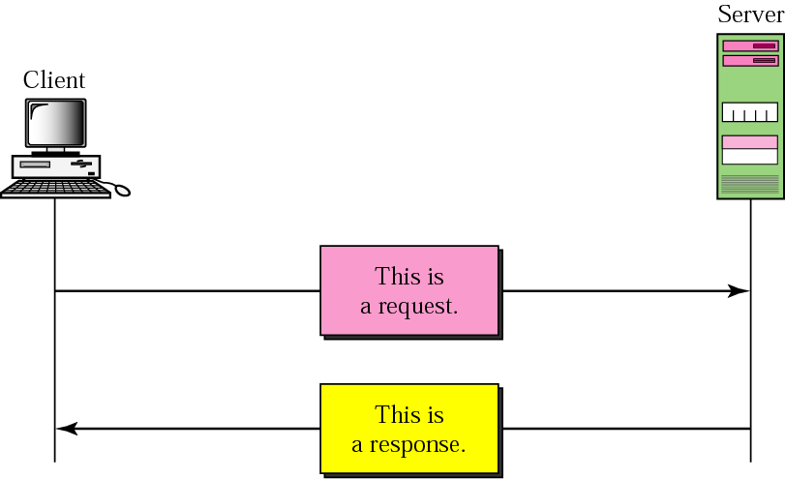
Figure 24-1
HTTP transaction

Slide 6
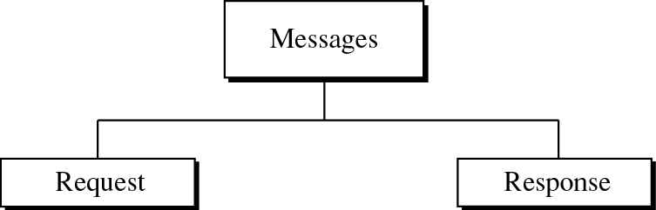
Figure 24-2
Message categories

Slide 7
24.2
REQUEST
MESSAGE

Slide 8
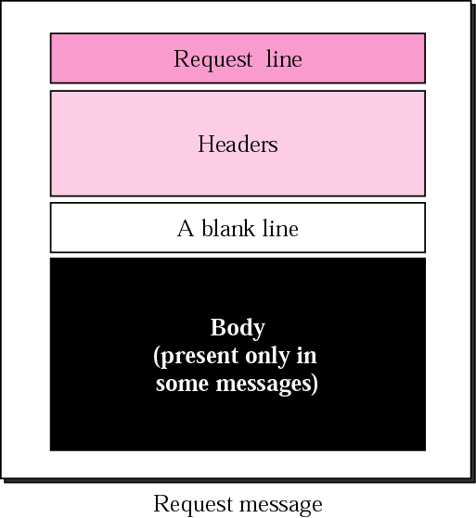
Figure 25-3
Request message

Slide 9
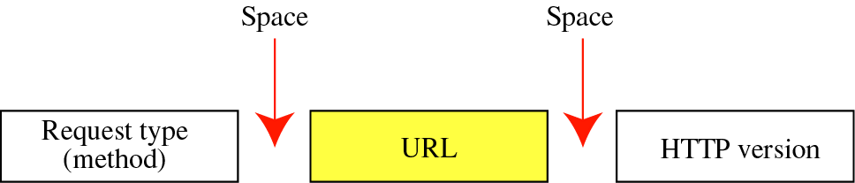
Figure 24-4
Request line

Slide 10
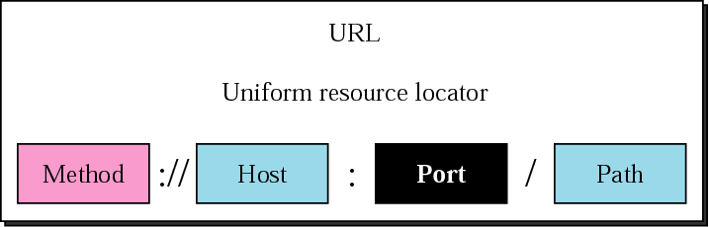
Figure 24-5
URL

Slide 11
24.3
RESPONSE
MESSAGE

Slide 12
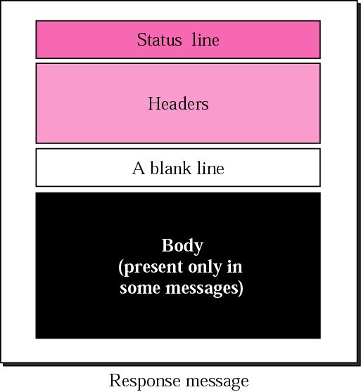
Figure 24-6
Response message

Slide 13
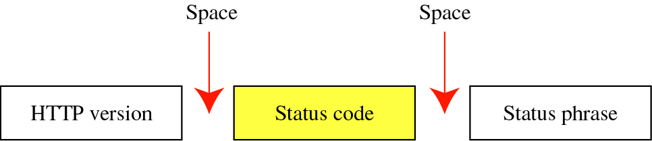
Figure 24-7
Status line
Status code: Same format as FTP responses (three digits)

Slide 14
24.4
HEADER

Slide 15
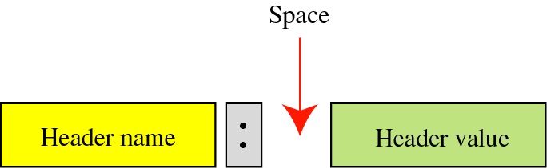
Figure 24-8
Header format

Slide 16
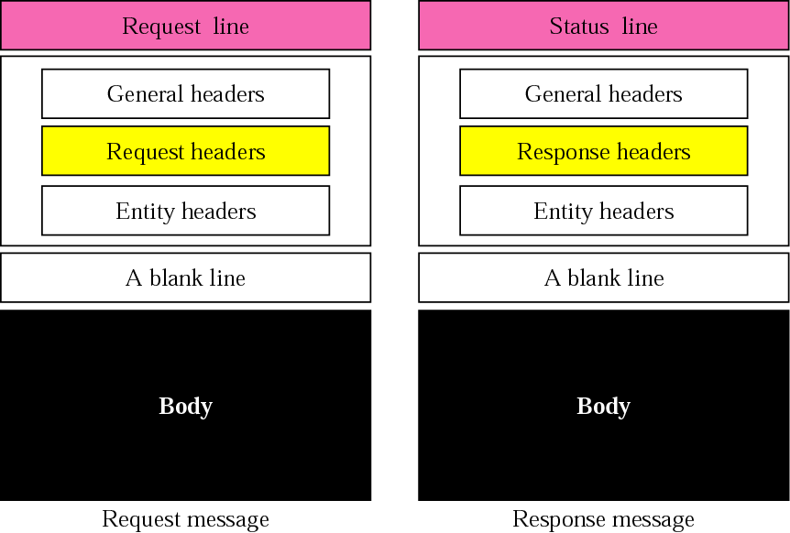
Figure 24-9
Headers

Slide 17
24.5
EXAMPLES

Slide 18
Example 1
This example retrieves a document. We use the GET method to retrieve an image with the path /usr/bin/image1.

Slide 19
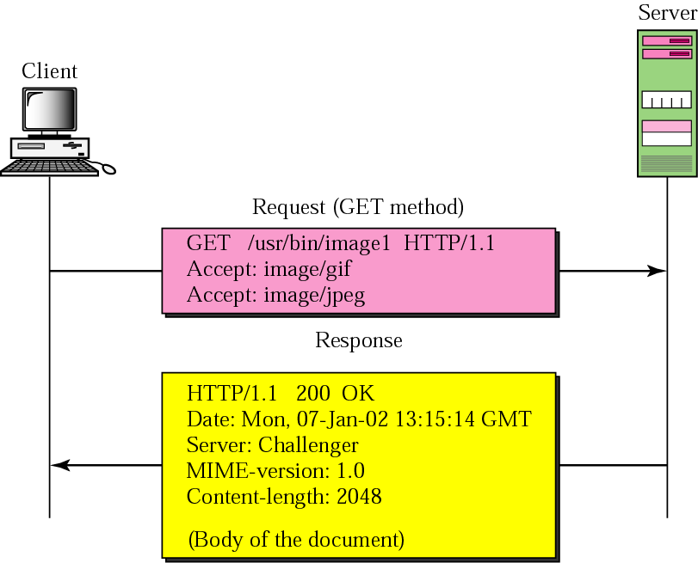
Figure 24-10
Example 1

Slide 20
Example 2
This example retrieves information about a document. We use the HEAD method to retrieve information about an HTML document (see Chapter 25)

Slide 21
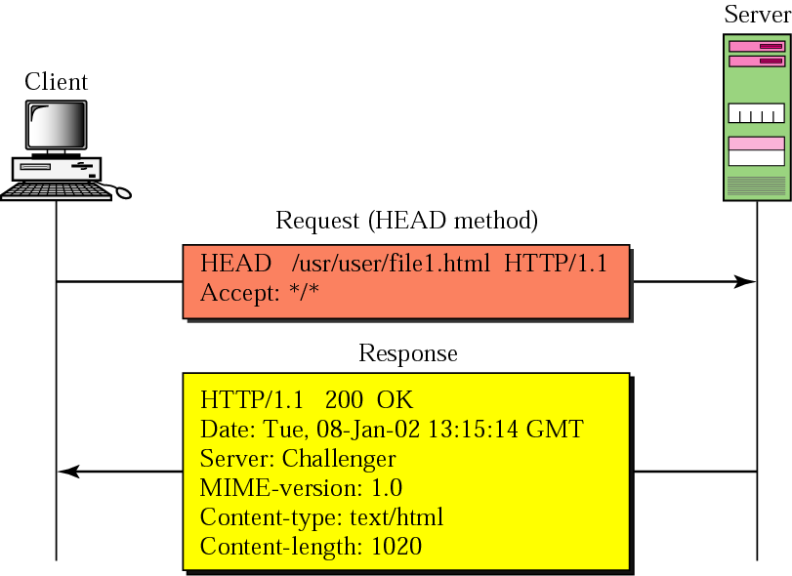
Figure 24-11
Example 2

Slide 22
Example 3
In this example, the client wants to send input data to the server. We use the POST method.

Slide 23
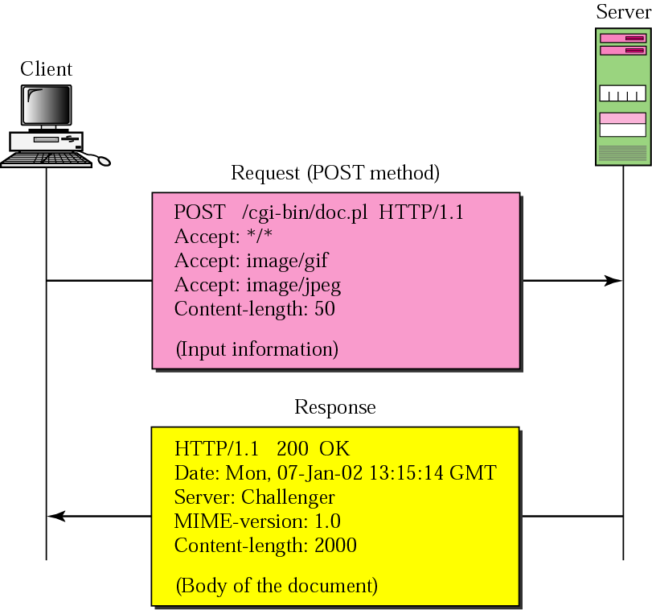
Figure 24-12
Example 3

Slide 24
24.6
SOME OTHER
FEATURES

Slide 25
HTTP version 1.1
specifies a persistent
connection by default.

